Slide 1
Pemrograman Berorientasi Objek
Pertemuan 2

Slide 2
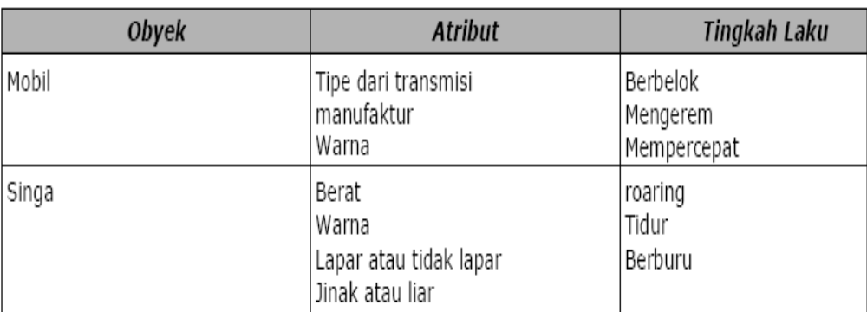
Pengenalan Pemrograman Berorientasi Obyek
Notes:
OOP berputar pada konsep dari obyek yang merupakan elemen dasar dari program Anda. Ketika kita membandingkan dengan dunia nyata, kita dapat menemukan beberapa obyek disekitar kita seperti mobil, singa, manusia dan seterusnya. Obyek ini dikarakterisasi oleh atribut dan tingkah lakunya.

Slide 3
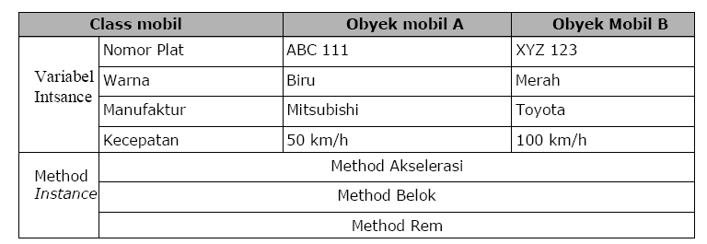
Pengenalan Pemrograman Berorientasi Obyek
objek adalah sebuah instance (keturunan) dari class

Slide 4
Pengenalan Pemrograman Berorientasi Obyek
Method
Karakteristik :
1. dapat mengembalikan satu nilai atau tidak sama sekali
2. dapat diterima beberapa parameter yang dibutuhkan atau tidak ada
parameter sama sekali. Parameter bisa juga disebut sebagai argumen dari
fungsi
3. setelah method telah selesai dieksekusi, dia akan kembali pada method
yang memanggilnya.

Slide 5
Bahasa Pemrograman
1. C++
Java
2. PHP5
3. Objective C
4. C#
5. Visual Basic .NET
6. Python
7. Ruby
8. Swift
Notes:
James Gosling, which resulted in a C++-based object-oriented programming language Sun called Java

Slide 6
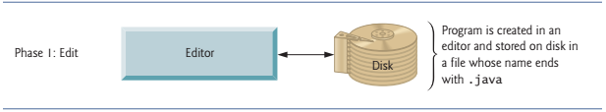
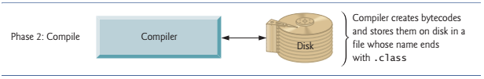
Fase Pemrograman Java
Notes:
IDEs provide tools that support the software development process, including editors for writing and editing programs and debuggers for locating logic errors—errors that cause programs to execute incorrectly. Popular IDEs include Eclipse (www.eclipse.org) and NetBeans (www.netbeans.org).
The compiler/ javac (java compiler) produces a .class file called Welcome.class that contains the compiled version of the program.
The Java compiler translates Java source code into bytecodes that represent the tasks to execute in the execution phase (Phase 5). Bytecodes are executed by the Java Virtual Machine (JVM)—a part of the JDK and the foundation of the Java platform. A virtual machine (VM) is a software application that simulates a computer but hides the underlying operating system and hardware from the programs that interact with it

Slide 7
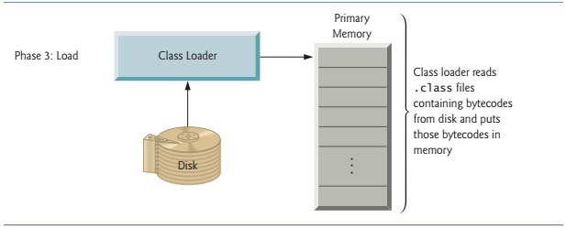
Fase Pemrograman Java
Notes:
The JVM’s class loader takes the .class files containing the program’s bytecodes and transfers them to primary memory. The class loader also loads any of the .class files provided by Java that your program uses

Slide 8
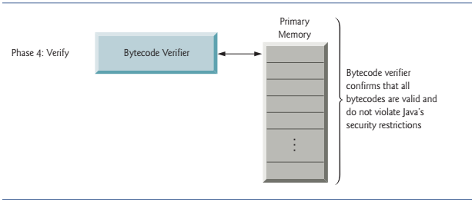
Fase Pemrograman Java
Notes:
the bytecode verifier examines their bytecodes to ensure that they’re valid and do not violate Java’s security restrictions (Fig. 1.9). Java enforces strong security to make sure that Java programs arriving over the network do not damage your files or your system (as computer viruses and worms might)

Slide 9
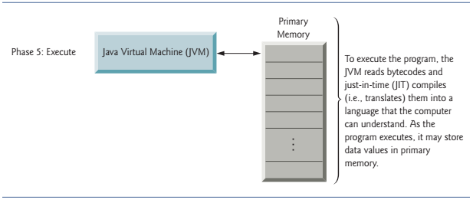
Fase Pemrograman Java
Notes:
the bytecode verifier examines their bytecodes to ensure that they’re valid and do not violate Java’s security restrictions (Fig. 1.9). Java enforces strong security to make sure that Java programs arriving over the network do not damage your files or your system (as computer viruses and worms might)

Slide 10
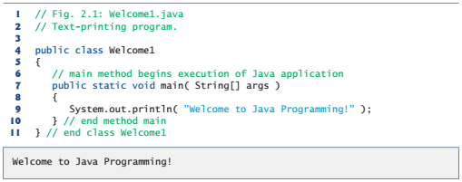
Pemrograman Java

Slide 11
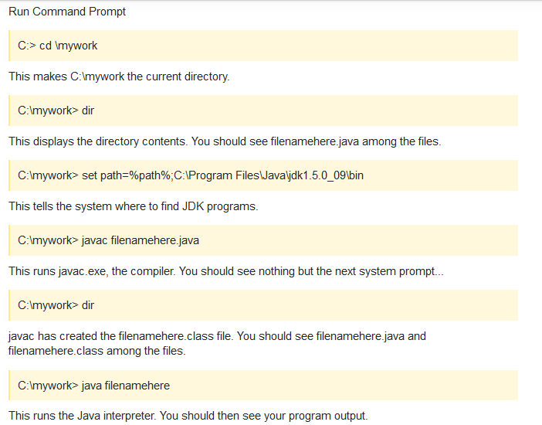


Slide 12
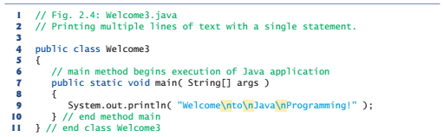

Pemrograman Java

Slide 13
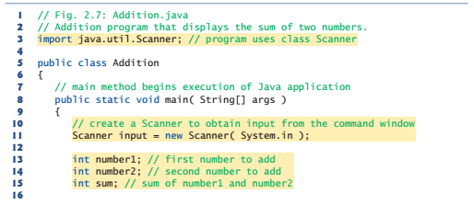
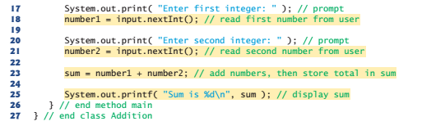
Pemrograman Java

Slide 14

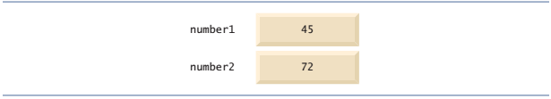
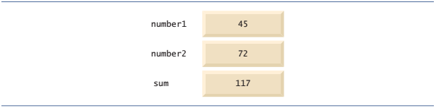
Memory Concept
Notes:
Variable names such as number1, number2 and sum actually correspond to locations in the computer’s memory. Every variable has a name, a type, a size (in bytes) and a value.

Slide 15
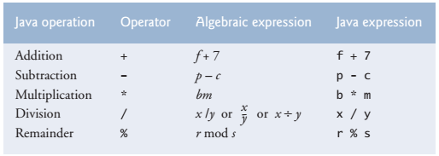
Aritmetic Operators

Slide 16
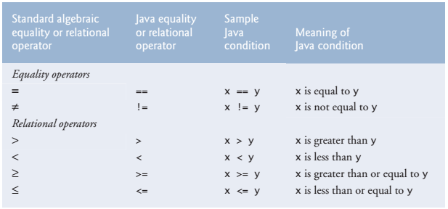
Equality and Relational Operators

Slide 17
Next Meeting
Materi:
  Struktur Percabangan,
  Perulangan
  Larik (Array)
  Tipe data Array
  Manipulasi array
  Array 2 dimensi

